Slide 1


Python SIG Day - 1

Slide 2
AGENDA OF DAY 1
1. Introduction to Python
• Installation of Python
• Overview of Python
2. Python Basics
• Variables and data types
• Input/Output operations
• Arithmetic and logical operators
3. Control Flow
• If-else statements

Slide 3

1. Introduction to Python!
Python is a high-level, interpreted, and versatile programming language known for its simplicity and readability. It is widely used in web development, data analysis, artificial intelligence, scientific computing, and more.

Slide 4

Key Features OF PYTHON :
Easy to learn and use
Interpreted and dynamically typed
Have Extensive standard library
Cross-platform compatibility
Massive open-source community Support

Slide 5
Python Syntax, Comments, and Indentation

Slide 6
What is Python Syntax?
1. In Python, we don’t need semicolons (;) like in C++ or Java. One line = one statement
Print Statements
A simple print() statement outputs text in the terminal.
Example: print("Hello")
Output: Hello
Common Error: Placing two print() statements on the same line causes a syntax error.
Example: print("Hello") print("World") # SyntaxError: invalid syntax

Slide 7
What are Comments?
Used to write notes in code to explain what it does.
Ignored by Python → Not executed.
Start with # (hash symbol).

Slide 8
Indentation in Python
Indentation is crucial for defining code blocks (e.g., in if statements).
Example:
name = "Radha"
if name == "Radha":
print(name) # Correctly indented;
Output: Radha
Common Error: Missing or incorrect indentation. Example:
name = "Radha"
if name == "Radha":
print(name) # IndentationError: expected an indented block
In C++/Java, we use {} for blocks. In Python, indentation defines blocks.

Slide 9
Variables and Data Types in Python

Slide 10
What are Variables?
A variable is just a name we give to a value we want to store.
Python variables don’t require an explicit declaration. Their type is inferred from the value assigned to them which is called dynamic typing.
Variables can hold different data types, such as numbers, text, lists, and more.

Slide 11
Declaring Variables
In Python, declaring a variable is as simple as assigning it a value using the = operator. No need to specify its type like in C++. Python is smart enough to figure it out!
Example:
python
Copy code :
x = 10
print(x) # Output: 10

Slide 12
Variable Naming Rules:
Valid Names
Must start with a letter or underscore (_).
Can only contain alphanumeric characters and underscores.
Are Case-sensitive (Age and age are different).
Reserved keywords in Python cannot be used as variable names (Eg - print, if, else, while, for, def, class, import, True, False, None)

Slide 13
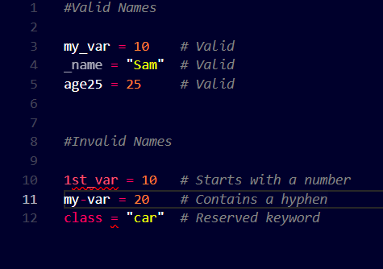
Examples

Slide 14
Data Types in Python

Slide 15
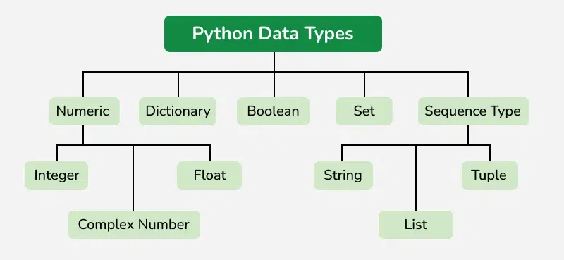

Slide 16
Numeric Data Types
Integers: It contains positive or negative numbers (without fractions or decimals). There is no limit to how long an integer value can be.
Float: It is a real number with a floating-point representation. It is specified by a decimal point.
Complex Numbers: It is represented by a complex class. It is specified as (real part) + (imaginary part)j. For example - 2+3j

Slide 17
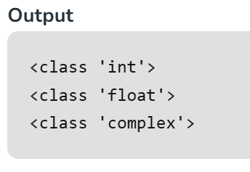
a = 5
print(type(a))
b = 5.0
print(type(b))
c = 2 + 4j
print(type(c))
Numeric Data Types

Slide 18
Sequence Data Types
Strings - sequence of characters enclosed in either single ( ' ) or double ( " ) quotes.
list:
A built-in, flexible, dynamic container.
Can hold different data types (e.g., int, str, float, etc.) in the same list.
Automatically resizes when you add or remove elements.
tuple: used to store an ordered, immutable collection of items..

Slide 19
Boolean Data Type
bool: True or False.
Booleans are most commonly used in conditional statements, comparisons, logical operations, and control flow (like if statements).

Slide 20
Dictionary
It is a data structure used to store data in key-value pairs.
Values in a dictionary can be of any datatype and can be duplicated, whereas keys can’t be repeated and must be immutable.
The dictionary can also be created by the built-in function dict().

Slide 21
Set Data Type
Set is an unordered collection of data types that is iterable, mutable, and has no duplicate elements.
The order of elements in a set is undefined though it may consist of various elements.

Slide 22
Classes and objects (class and object).
Functions can also act as data (first-class functions).
User-Defined Types

